Slide 1



HOTEL BOOKING APPLICATION
~DEEPANSHI SHARMA (2200290140052)
~KAJAL KHUSHWAHA (2200290140077)

Slide 2


INTRODUCTION
The Hotel Booking Application is a user-friendly mobile application designed to simplify the hotel reservation process for travellers. In today's fast-paced world, where convenience and efficiency are paramount, this app provides an intuitive platform for users to effortlessly discover, book, and manage their accommodations. This abstract provides an overview of the key features and benefits of the hotel booking app.
The primary objective of the Hotel Booking App is to provide travellers with a seamless and personalized experience when searching for and booking hotels.

Slide 3
Technologies
HTML
Bootstrap
Node js
React
API

Slide 4
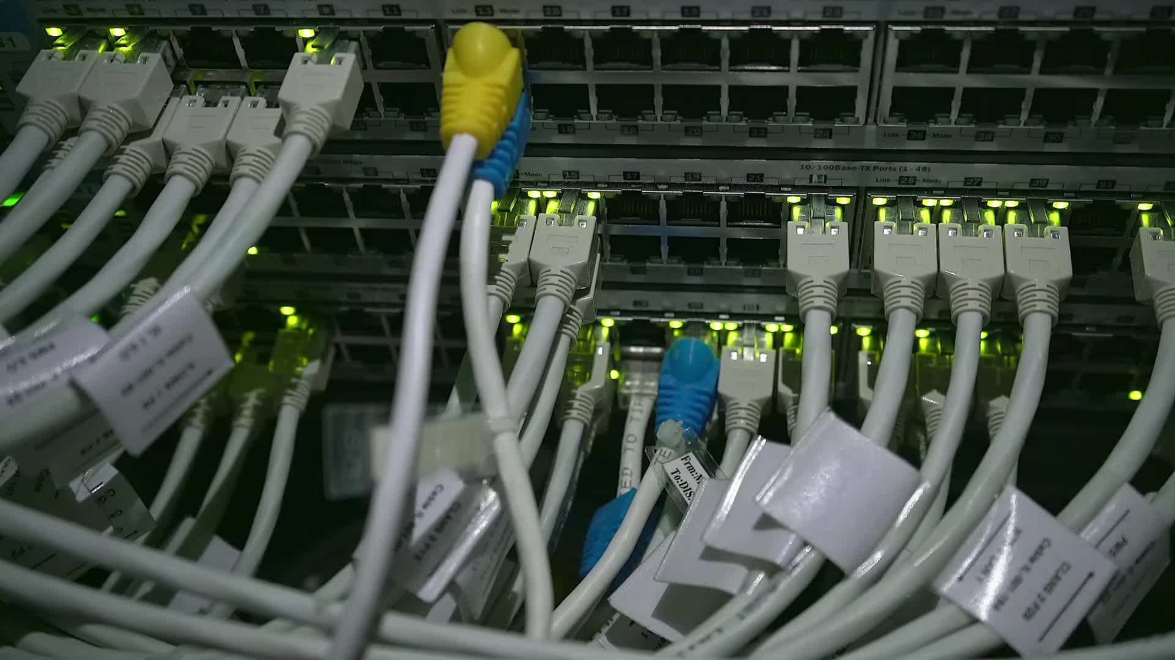
HARDWARE REQIUREMENT
1. Server Hardware
2. Storage
3. Database Server
4. Networking
5. Backup and Redundancy

Slide 5
Modules
1. User Registration and Authentication: This module allows users to create accounts, sign in securely, and manage their personal information. It's the foundation for personalized experiences and booking history tracking.
1
2. Search and Booking: This is the core module of the app, enabling users to search for hotels based on criteria such as location, check-in/check-out dates, room preferences, and pricing. Users should be able to view available rooms and make bookings through this module.
2
3. User Profiles: User profiles are essential for managing bookings, viewing past reservations, and updating personal information. Users should have the ability to track their booking history and modify their profiles as needed.
3
4. Payment Gateway: The payment gateway module facilitates secure and convenient online transactions. It should support various payment methods, including credit cards, digital wallets, and other popular options, ensuring smooth payment processing for users.
4
5. Notifications: This module handles push notifications and email alerts to keep users informed about their booking status, confirmations, reminders, and updates. Timely notifications are crucial to maintaining user engagement and ensuring a seamless booking experience.
5

Slide 6
Conclusion
The rapid advance of technology has transformed daily life, with smartphones, the internet, and artificial intelligence reshaping how we live and work. These changes bring unprecedented convenience and global connectivity but also challenges like data privacy and automation-related job concerns. Striking a balance between technology's benefits and drawbacks is crucial for individuals, businesses, and society. By harnessing technology wisely, we can enhance our lives while safeguarding our values.

Slide 7

THANK YOU

